Slide 1
How did the Planets in our Solar System get the way they are?
Case Studies in Planetary Evolution

Slide 2
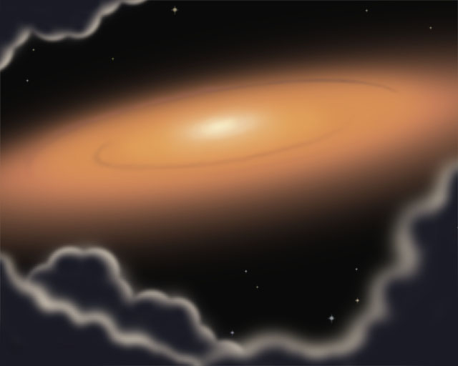
Week 1 Review – Solar System Formation Processes
Beginning: pre-solar nebula (T Tauri star)
Accretion of planets in protoplanetary disk
Sun enters main sequence: accretion ends
Planetesimals collide and shift orbits
Planetary evolution processes begin to take over!

Slide 3
The Planets Settle Down
Surfaces start out molten at end of accretion
Begin cooling processes – surfaces become solid
  Less energy inputs from collisions per unit time
Continued small bombardments – adds surface elements, atmospheric features (chemical composition)
  Cratering, water and other ices on some inner bodies (on others it likely escaped)
Still huge amounts of heat in planets: very active convection
  Very hot surfaces
  volcanism

Slide 4
General Evolutionary Processes
Surface
  Cratering
  Volcanism (from interior)
  Atmospheric changes (chemical – interaction with surface, wind down to a steady state)
Interior
  Processes driven mostly by heat – convection and conduction of heat to surface
  Magnetic field generation (heat-based, rotation speed-based, and composition-based)
  Slow cooling – solidification

Slide 5
The Inner Solar System
Terrestrial Planets

Slide 6
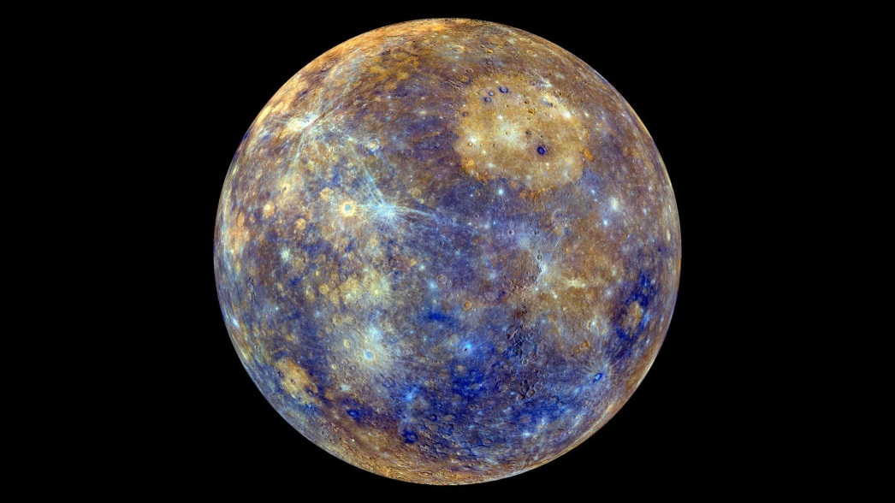
Case: Mercury
No atmosphere
Weak magnetic field (1% of Earth’s)
Thick core: thought to be result of collision and its place in the solar system (remember: which elements would condense here?)
  75% of radius
Cooling led to crust shrinking – evident in scarps (long ridges on crust)
Lava fields
Impact craters! (most obvious surface feature)
Seismic features (thought to be often related to impact craters – antipodal region)

Slide 7
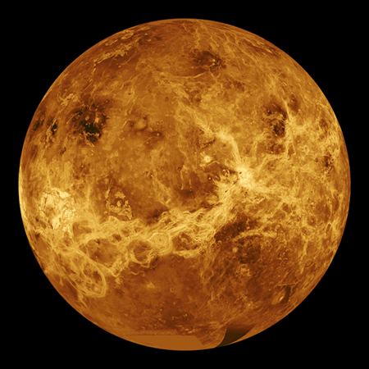
Case: Venus
Slow rotation – no dynamo, magnetic field
Atmosphere
  Very thick – 93x mass Earth’s
  carbon dioxide composition
    Greenhouse effect > HOT planet
    Sulfur dioxide clouds! > poison!
  Solar wind ‘erodes’ low mass molecules – similar to Mars
Surface and interior
  Similar composition to Earth, as well as size
  Volcanic resurfacing relatively often
  Little cratering – b/c resurfacing and thick atmosphere
History
  Formed as an Earthlike planet; liquid water oceans
  No carbon cycle (no life/plate tectonics): carbon dioxide accumulated; heated atmosphere
  Runaway greenhouse effect (feedbacks)
  Heat caused water to evaporate, then solar wind photodissociated water

Slide 8
Case: Mars
Many surface and mantle processes have wound down
Mars History
  Accretionary composition: more low-boiling point elements than Earth
  Noachian period: LHB-era; 4.1-3.5 BYA
  Bombardment and cratering
  Intensive volcanism and uplift
  Hot enough interior for liquid outer core- magnetic field generated
  North and south very different – why?
    North – vast basalt lava plains, smooth (less cratered) -> younger age
    South – higher terrain, less dense composition, more heavily cratered -> older!

Slide 9
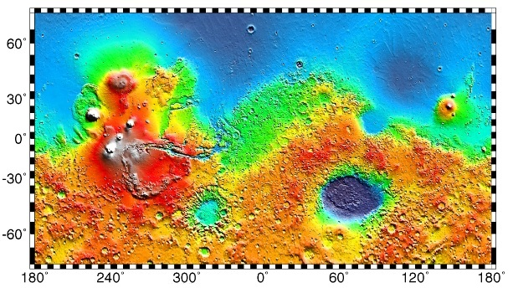
What could cause this dichotomy?

Slide 10
Case: Mars
Noachian period: continued (4.1-3.5 GY)
  Theories of North-South dichotomy:
    Most widely accepted theory: massive impact
    Glancing angle; ~size of Pluto, ½ moon
    Blew off crust; basalt (similar to mantle material below crust) replaced it – explains composition, smoothness, and low relief
  Late Noachian period: liquid water
    Thicker atmosphere
    Magnetic field present
Hesperian period: (3.5-3 GY)
  Transitional period from wet Mars to dry Mars
    Lessening of magnetic field, loss of atmosphere
    Freezing and loss of water
  Extensive lava flooding, volcano building
Amazonian period: (3 GY-present)
  Dry, frozen Mars w/ thin atmosphere
    Likely: occasional water flows
  Lava flows, volcanism (not as pronounced as Hesperian)

Slide 11
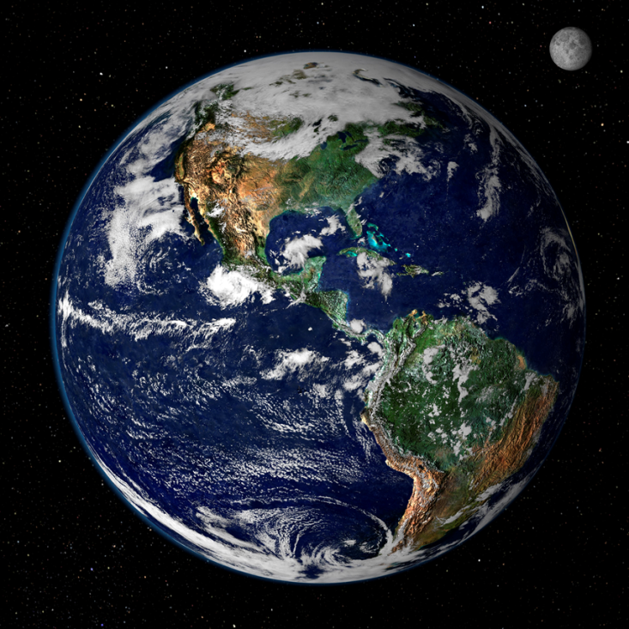
Case: Earth!
Dynamo-generated magnetic field
23 degree axial tilt – seasons! (Mars also has this)
Large moon: tides in fluids (water)
Atmosphere
  Mainly nitrogen
  Unexpected: oxygen!
Surface
  Liquid water
  Continental and oceanic crust – light v. heavy
  LIFE!
    Solves our oxygen conundrum!
    Continual input of energy allows change of chemical composition

Slide 12
The Outer Solar System
Jovian Planets and their Moons

Slide 13
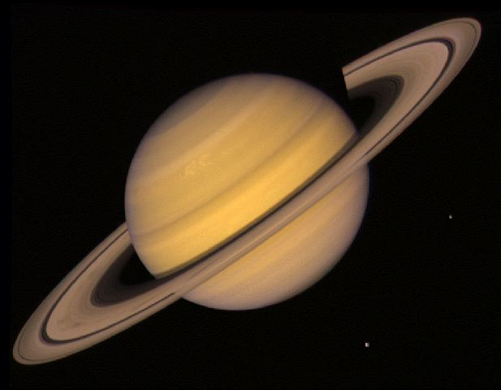
Jovian Composition + Evolution
Primarily gaseous: hydrogen and helium
Strong magnetospheres– dynamo generated by metallic hydrogen! (extreme-pressure H)
Multiple satellites (formed by accretion and capture)
Weather and “rain” through different parts of atmosphere
Evolution: as they cool, migration of helium to core (continued differentiation – fluids are not miscible as temperature lowers)

Slide 14
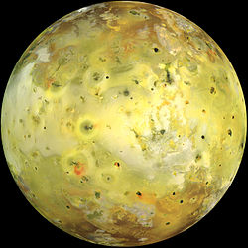
Volcanic Satellites - Io
Volcanism has a different cause here – Io is too small for internal heating to cause such volcanism!
  Why does it have it?
  Tidal forces!
  Jupiter’s pulling heats Io (friction) and that heat creates melts that erupt from the surface
    Lava flows and volcanos
    Sulfrous
  Additionally, orbital resonances – 1, 2, 4 (Io, Europa, Ganymede)
Cryovolcanism (cryo=ice) found on satellites of icy composition and lower temperatures
  (remember, they formed towards the edge of the solar system!)

Slide 15
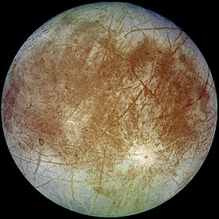
Icy Satellites - Europa
‘ices’ referring to materials with low boiling points (water, ammonia, methane)
Europa – best studied example of icy satellite
Tidal forces are less strong; produce enough heat for subsurface liquid water ocean in Europa’s case (otherwise moon would be frozen solid)
Subaqueous volcanos likely
Dissolved ions in water ocean create weak magnetic field
Surface ice – frequent resurfacing from below, mostly through cracks, fissures (think of ice floes)

Slide 16
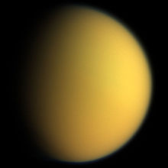
Icy Satellites - Titan
Fairly distant from Saturn (not strong tidal heating)
Tidally locked (one face to Saturn)
Composition:
  Colder than Europa
    Water ice = rock (and generally deeper)
  Ammonia, methane, ethane compounds
  Larger than the Moon and Mercury!
Atmosphere:
  Very thick – nitrogen, methane, ethane, carbon/nitrogen compounds
  Hazy; visible light does not penetrate
  Nitrogen cycle
  Seasonal weather (long seasons)
Surface:
  Smooth (young; resurfaced); some craters
  Mountains, cryovolcanos
  Methane, ethane lakes (standing surface liquid!!)
    Flow features

Slide 17

So Where Might Life Be?
Life – think of it as a crustal process with very specific energy and chemistry requirements

Slide 18
So Where Might Life Be?
Life – think of it as a crustal process with very specific energy and chemistry requirements
Titan
Europa
Mars
WHY?

Slide 19

So Where Might Life Be?
Life – think of it as a crustal process with very specific energy and chemistry requirements
Titan
  Carbon-based compounds (which, with energy input, could form amino acids, other organics)
  Would have to be non-water based (too cold)
Europa
  Liquid water ocean
  Energy source: tidal heat (volcanos- like black smokers)
Mars
  Subsurface aquifers may be warm enough
  Past life possible (Noachian period) – liquid oceans (same with early Venus?)

Slide 20
What can we infer about general planetary evolution from these cases?

Slide 21
General Planetary Evolution
Common driving factor- HEAT
Terrestrial Planets
  Mantle heat -> volcanic processes
  Surface/atmosphere interaction
  Liquid water plays a huge role
  Atmosphere – presence/absence, level of greenhouse
Jovian Planets
  Gaseous, huge mass
  Strong magnetic fields
  Many moons
Icy planets/moons
  Heat from tidal forces
  Water and carbon compounds possibly present

